Slide 1




FinTech Workshop Conversational Future of Payment
proudly presented by

Slide 2
Agenda
The challenge
Companies
Scenarios
APIs and Data
Q&A

Slide 3
The challenge

Slide 4


?
FACE
VOICE
Your ideas?
Your Task: How will we pay in the future?

Slide 5

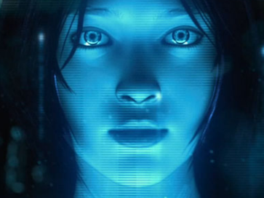
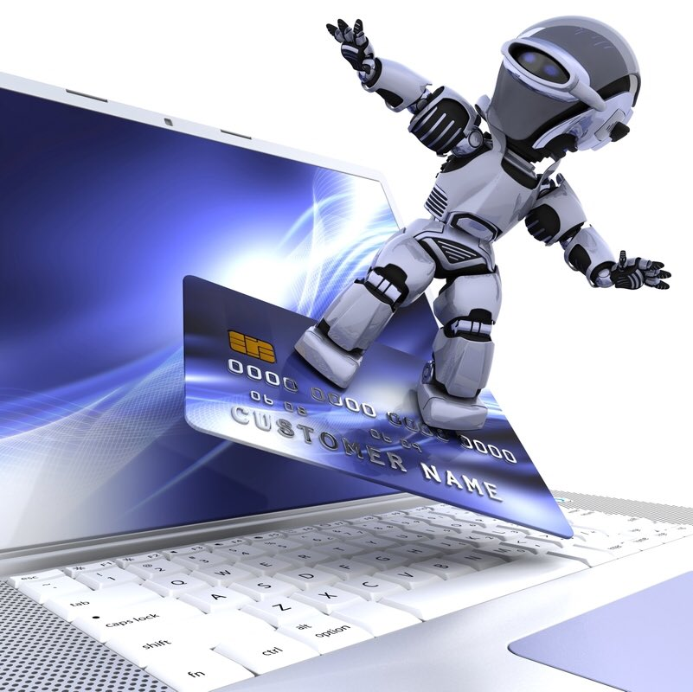
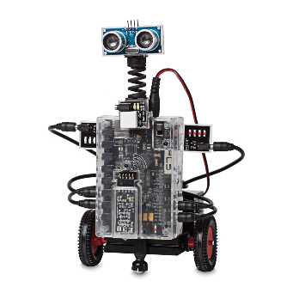
Your tools …
ti&m Joy
Ready-to-order API
Microsoft Cognitive Services
voice actions, login via face
IoT – the vending machine at your service
Rasperi PI 3, electro servos, cardboards
Aduno Payment
real payment API & Dataset
Devices for you: Surface, iPhone/Android, Smart Watches, Rasperi PI 3 … and a lot more

Slide 6
Companies

Slide 7



ti&m
We digitalize your company.
Consulting. Design. Agile Projects. Products. Innovation Hosting. Garage.

Slide 8
Our strengths – What makes us different
ti&m stands for technology, innovation & management.
We are the Swiss leaders in projects and products for digitalization, security and innovation, and strive to achieve the same position in the financial sector in Europe.
Vertical integration The foundation for game-changing ideas.
Talent Excellent engineers, designers and consultants guarantee a time-to-market that leaves the competition behind.
Agility & dynamism Rapid response to market trends and client needs.
Driven by sustainable values Shattering conventions as the basis for innovation.
Entrepreneurial courage Minimizing the risks for our clients. Optimizing the potential for success.

Slide 10

Aduno Group – Payment Issuing
1.4 Mio. Cardholders from Swiss Retail-/ Cantonal Banks plus self-issued Portfolio
Credit and PrePaid MasterCard® and Visa cards
Mobile and digital are the waves of the future

Slide 11
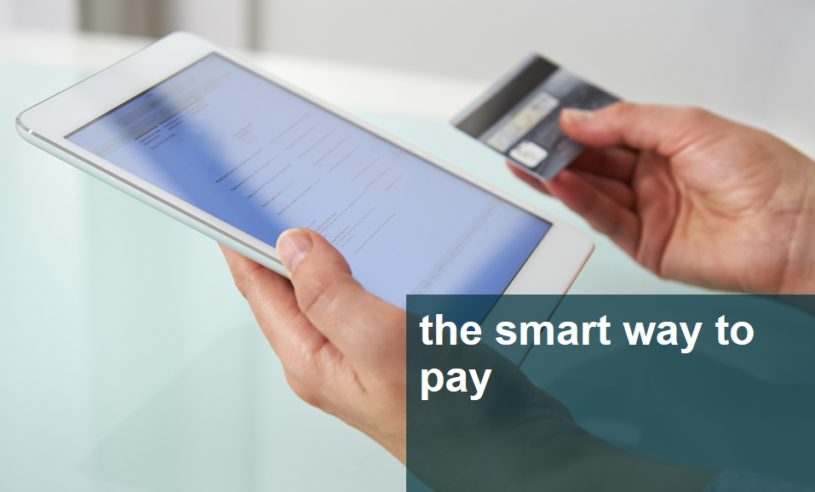
Aduno Group – Payment Acceptance
Payment acceptance at some 50,000 points of sale
First Mover in Mobile Contactless Payment initiative in Switzerland (since 2007)
Acquirer and POS terminal solution provider
Own Loyalty programme «surprize»
Strong in Data Analytics

Slide 12

Aduno Group – Innovation Management
The next countdown has started for:
IOT, Wearables and NLP is the future
Blockchain initiatives ongoing
We look for your contribution to groundbreaking new solutions!

Slide 13
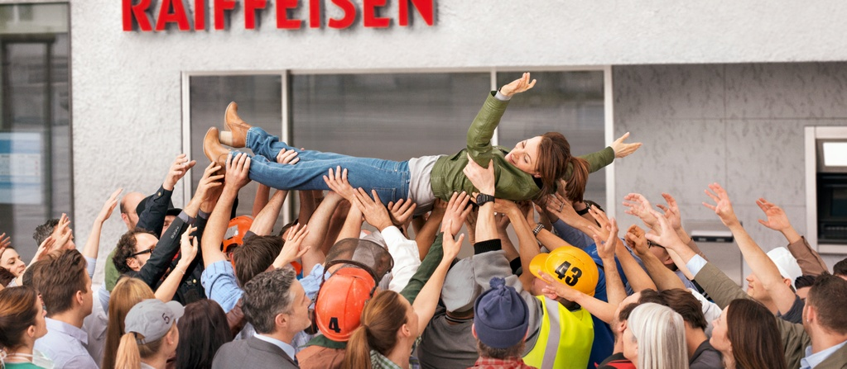
Raiffeisen Group
@ HackZurich

Slide 14
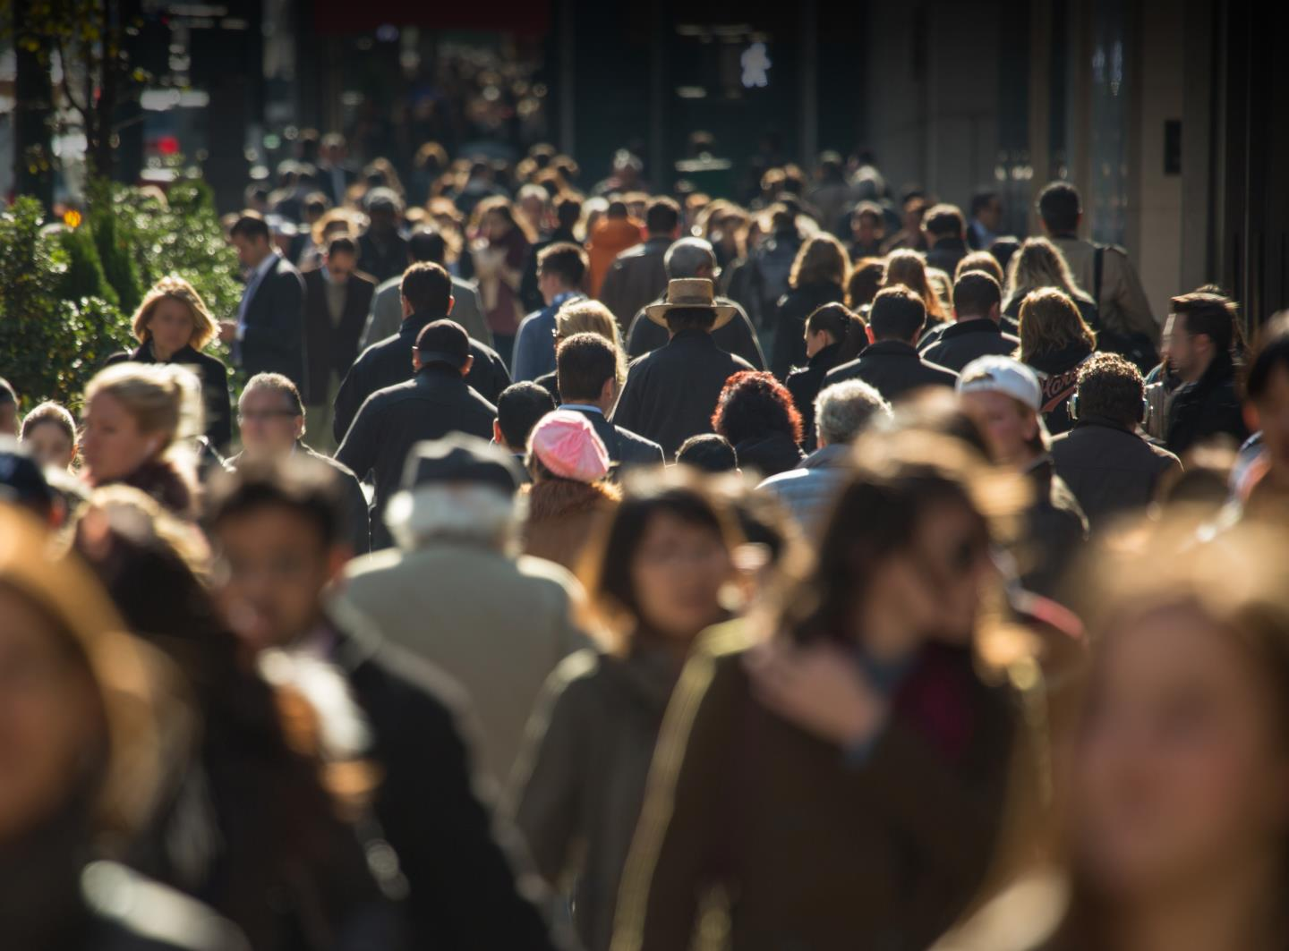
Common ground in Switzerland
Every
2nd
Common vision
Still being the leading retail bank in Switzerland tomorrow
adult
Every
3rd
company
Notes:
click: There's one thing that every 2nd adult
click: And every 3rd company in Switzerland have in common...
click: What could that be?

Slide 15
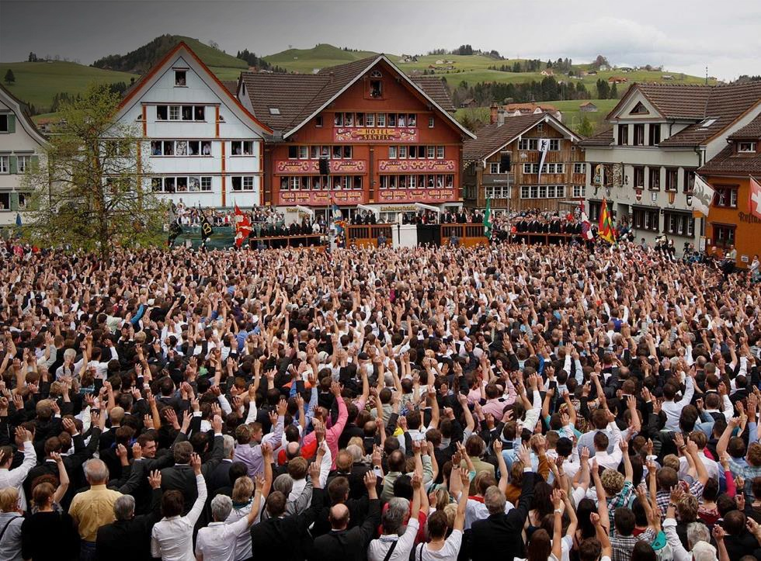

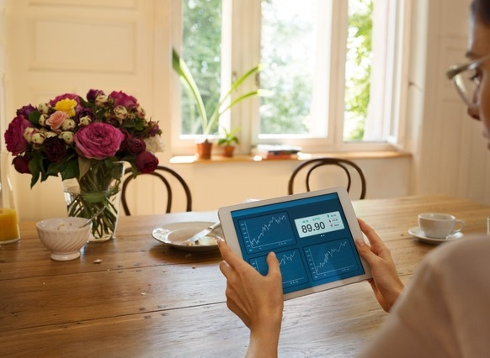
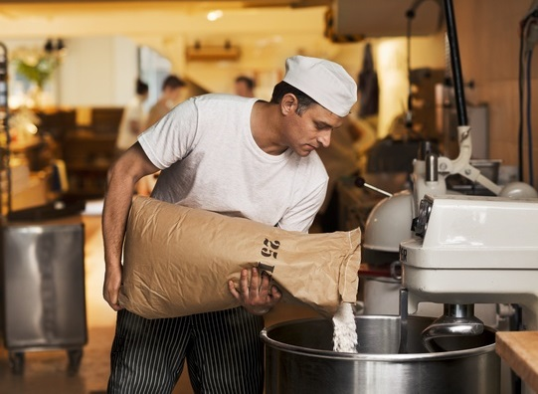
Leading in providing advice: Actively accompanying clients in all life situations
Private clients
Investment clients
Corporate clients
Payments
Savings
Financing
Provisions
Insurance
Investments
Individual, specific needs for sustainable asset accumulation
Payment services
Investments
Liquidity
Risk hedging
Company founding
Succession planning

Slide 16

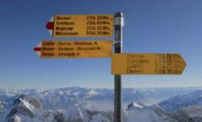




Raiffeisen is committed to Switzerland in a variety of ways
Management of sustainability: “Creating profits and values”
Responsibility in the core business: “In touch with the latest trends”
Responsibility as an employer: “Inspiring and integrating people”
Responsibility in banking operations: “Credible from the inside out”
Corporate social responsibility: “In the tradition of the cooperative”
Responsibility along the added-value chain
Products and services for today and tomorrow
Implemented diversity and equal opportunity
Resource-conscious, future-capable banking group
Involved in and for Switzerland

Slide 17
Scenarios

Slide 18




Log in with face and/or voice A simple challenge – identify via face or voice: You may use Microsoft Cognitive Services
Scenario
For buying or paying stuff in an app you often have to log in, that’s often cumbersome. You want to be identified simply by showing your face or using voice with your phone.
«I am Bob»
Yes, you are!

Slide 19
Shop with hands free Talk, don’t click (or point).
Scenario
20 % of all search queries on Android in the US are coming from voice*.
Won’t take long, and then we are used to seeing people giving voice orders to their cell phones.
Figure out, how you would navigate, order and/or pay stuff in an future shopping application.
«One Banana»
1 Swiss
Franc
«OK!»

Slide 20




Delivery by bots, autonomous cars When the shop comes to you.
Banana
Scenario
Amazon, DHL, Swiss Post and others are working on new delivery solutions.
Show that this is not rocket science.
Help us to create a crazy delivery solution (robot, next level vending machine, autonomous delivery vehicle etc.)

Slide 21










To give you some inspiration Create the next level vending machine.
Scenario
Use emote beacons to the get recognized by the vending machine.
Use Bing Speech API to order something and pay your goods
Use the Aduno payment interface to do a transaction
We provide you with scissors, cardbox, duct tape, Arduino kit, estimote beacons to create the next level vending machine!
Or bring something of your own to impress the future!
Estimote Beacons
Localisation by Bluetooth Beacons
Face & Voice
Authentication via Face/Voice
Burger
«Banana»
«OK»
Banana
App Joy
Use ti&m’s shopping app and extend it with exciting features (Estimote Beacons implemented)
Payment
With Aduno payment interface

Slide 22
To give you some inspiration Talk directly to the box.
Scenario
Why wait at the counter?
Help yourself with the “self-service box”!
Voice recognition
Talk directly to the box
Burger
Banana
Payment
With Aduno payment interface

Slide 23
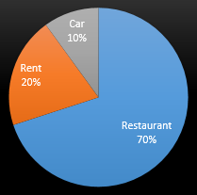
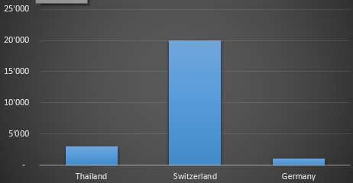
Query PFM database (via voice control)
Scenario
Query the PFM database using your voice via Siri, Cortana, Google Now or Amazon Echo. For example: - "How much did I spend on restaurants last month?" - "How much do I have left in my groceries budget?" - "How much did I spend in Thailand this year?" - "When was the last time I went to Starbucks?"
Voice recognition
Talk directly to the PFM

Slide 24

Order items conditional on budget
Scenario
- Make an order for sth. conditional on the remaining budget. For example, if one wants to buy some nice bottles of wine, one could say: "Siri, order as many bottles of wine XYZ as my budget allows".
- Place a recurrent order, conditional on the budget situation. F.ex. at the end of every month 4 bottles of wine are ordered, but only if there is more than 100CHF left in the groceries budget.
Voice recognition
Conditional ordering Wine
Wine

Slide 25

API Speech & Facial Recognition your body interface
provided by

Slide 26
API Documentation – Speech Commands
Using Microsoft Bing Speech API. This API is a cloud-based API that provides advanced algorithms to process spoken language. With this API, developers can add speech driven actions to their applications including real-time interaction with the user.
Microsoft's cross-platform REST API enables speech capabilities on all internet-connected devices.
API Documentation https://www.microsoft.com/cognitive-services/en-us/speech-api/documentation/overview
Sample for JS Implementation https://www.microsoft.com/cognitive-services/en-us/speech-api/documentation/getstarted/getstartedjs
Coupons for Azure @ Raiffeisen Stand

Slide 27
API Documentation – Facial Verification Used for identifying the delivery of a Gold Bar via Face Recognition
Using Microsoft
Using Microsoft Bing Speech API. This API is a cloud-based API that provides advanced algorithms to process spoken language. With this API, developers can add speech driven actions to their applications including real-time interaction with the user.
Microsoft's cross-platform REST API enables speech capabilities on all internet-connected devices.
API Documentation https://www.microsoft.com/cognitive-services/en-us/face-api https://dev.projectoxford.ai/docs/services/563879b61984550e40cbbe8d/operations/563879b61984550f3039523a
Sample Implementation
https://dev.projectoxford.ai/docs/services/563879b61984550e40cbbe8d/operations/563879b61984550f3039523a/console
Coupons for Azure @ Raiffeisen Stand

Slide 28
Joy order app skeleton
provided by

Slide 29

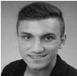
What is “Joy”?
We provided a Payment App which you may use as a quick-start for you payment solution or helps to quickly implement the Aduno payment interface.
The basic use case is ...
The Joy app “enters a shop” (check-in is done automatically with Bluetooth beacons).
User selects bananas and chocolate.
User hits pay.
The user gets bananas and chocolate from the merchant and leaves.
Ask the boss!
Alban Veliu Software Engineer at ti&m Alban.Veliu@ti8m.ch, +41 (0)77 259 89 16 Programmed Joy

Slide 30
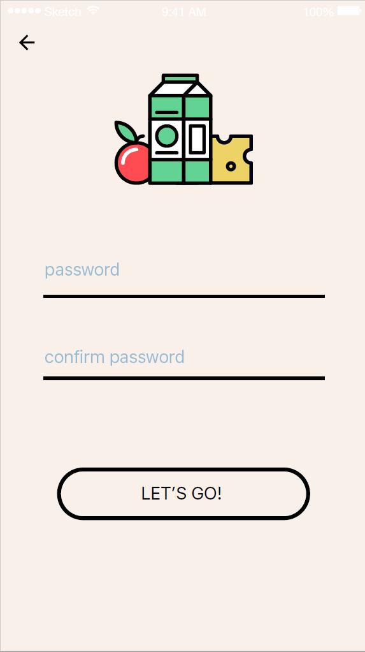
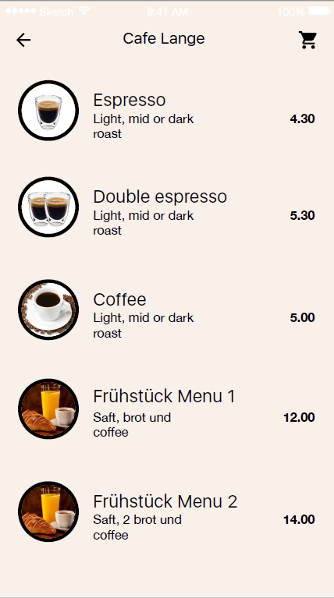
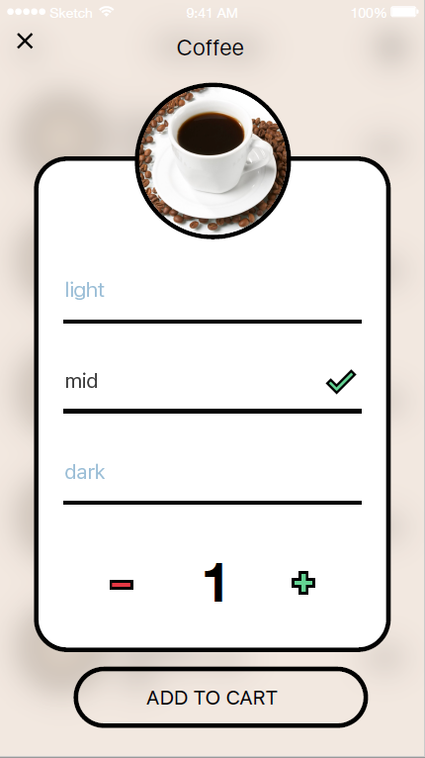
What is “Joy”?

Slide 31
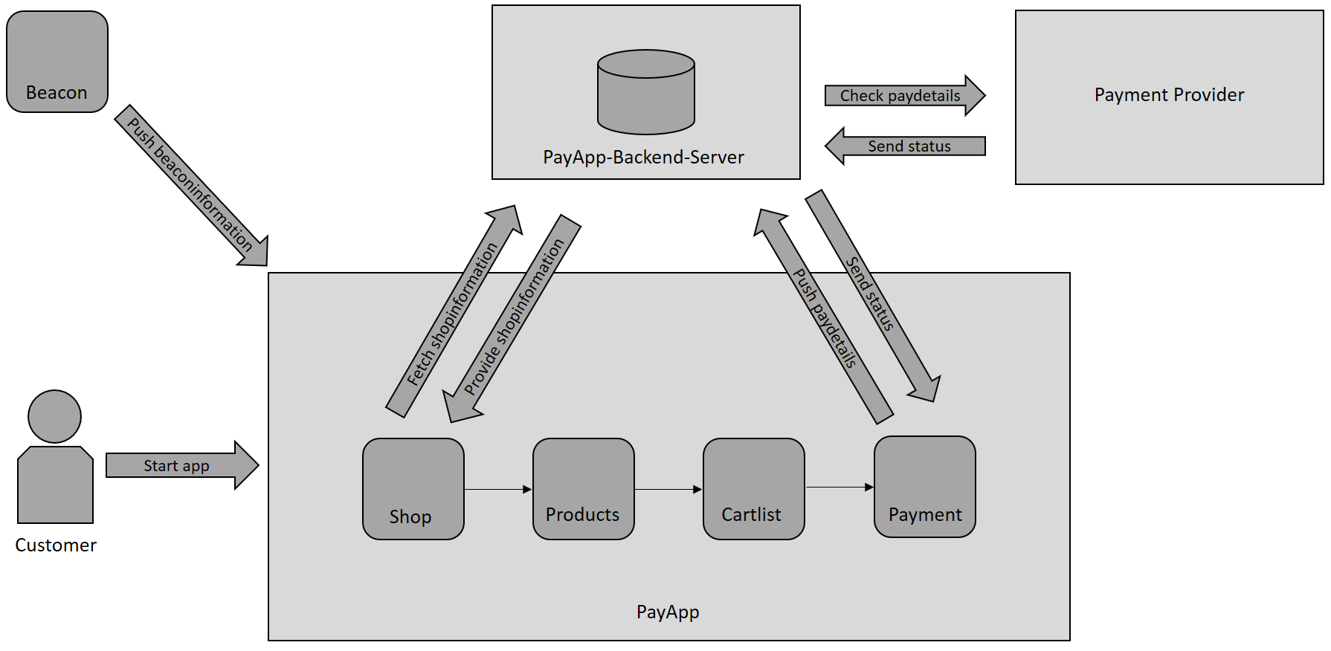
Joy Architecture

Slide 32
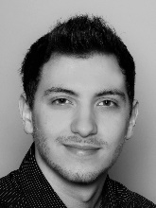
Important Classes
CustomerService.java
register()
login()
StoreService.java
getStore()
getShopProduct()
Rest-API
StoreRestService.java; CustomerRestService.java
Ask the boss!
Fatih Hocur Software Engineer at ti&m hocur.hackzurich@outlook.com Programmed Joy

Slide 33
Important API’s & Repositories
Joy React Native:https://facebook.github.io/react-native/docs/getting-started.html
Spring: http://docs.spring.io/spring/docs/current/spring-framework-reference/htmlsingle/
Hibernate mit JPA: https://spring.io/guides/gs/accessing-data-jpa/
Gradle: https://docs.gradle.org/current/userguide/userguide.html
Git-Repository Joy: https://github.com/ti8m/HackZurich16/tree/master/joy/

Slide 34
IoT Deliver the goods with robots or vending machines!
provided by

Slide 35
What is “IoT”?

Slide 36
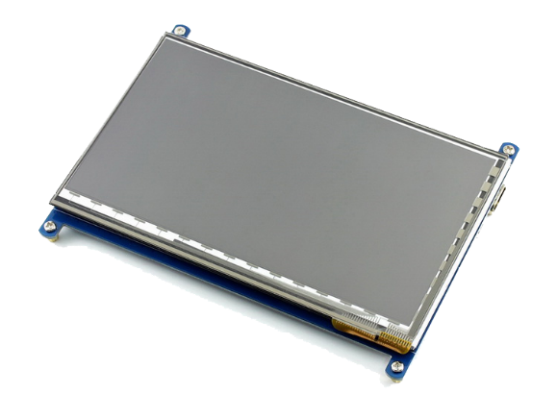
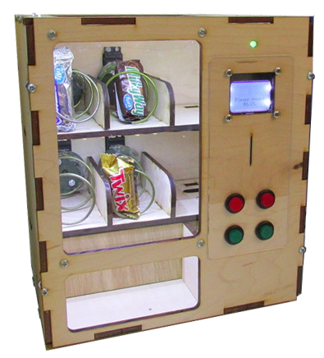
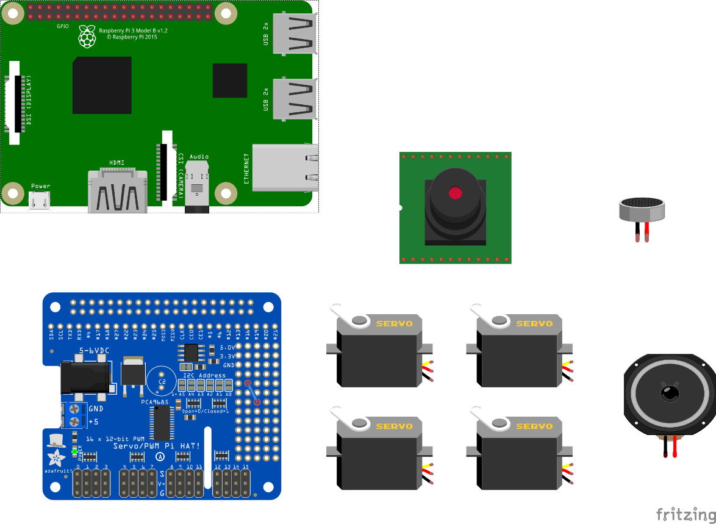
The IoT Vending Machine
Raspberry PI 3
5” Touch
PWM Servo Controller

Slide 37
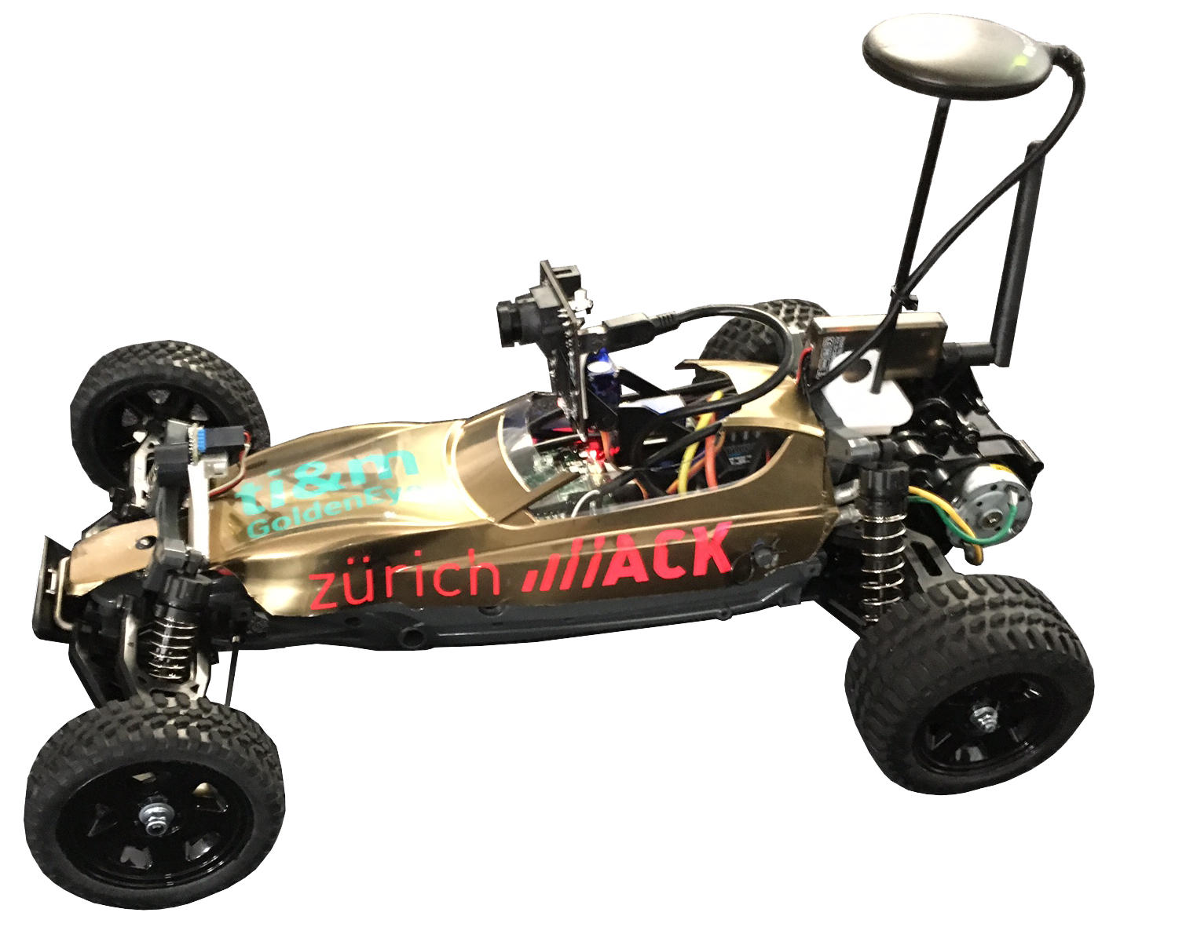
GoldenEye - The Autonomous Delivery Rover

Slide 38
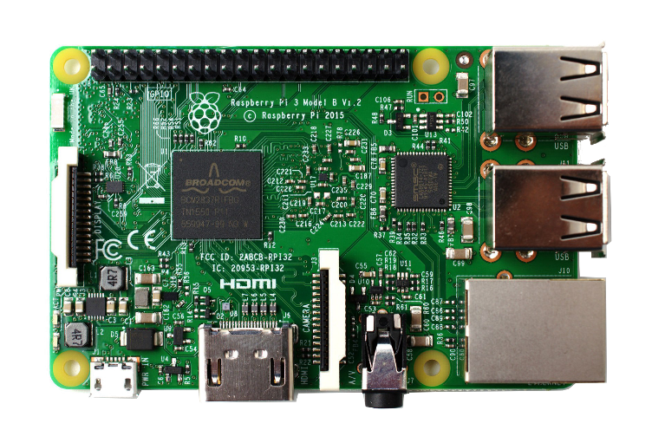
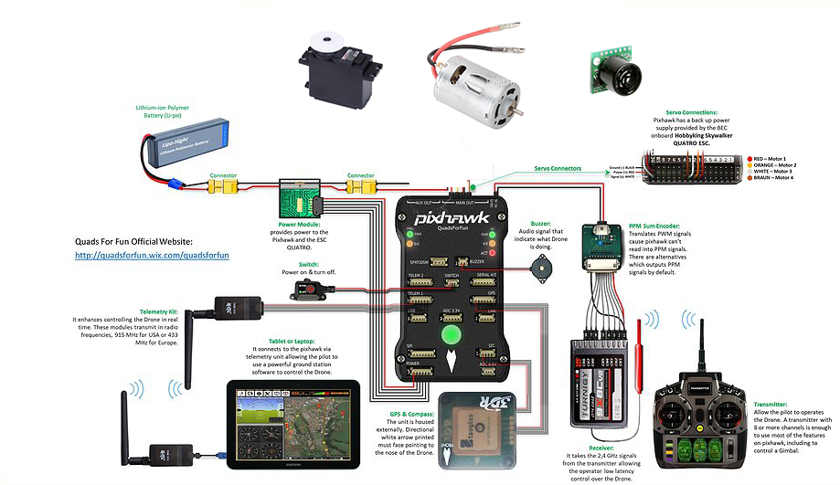
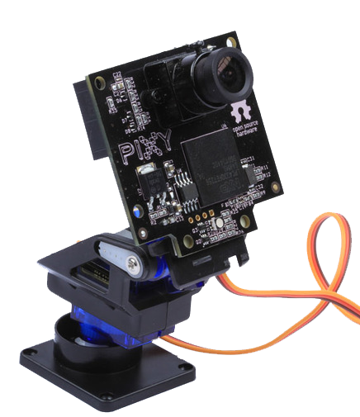
GoldenEye – Hardware & Sensors PI 3 + more than 10 Sensors + real-time Telemetry

Slide 39
GoldenEye – Software Programming the Mission on the Raspberry PI

Slide 40

Personal Finance Management (PFM) - Data
in cooperation with

Slide 41
Datasample
PFM_Budget
BUDGET_ID | ACCOUNT_ID | CATEGORY_CODE | NAME | AMOUNT | CURRENCY | FREQUENCY_TYPE
1 | 1001 | cv_groceries | My Monthly Groceries | 400 | CHF | MONTH
2 | 1001 | cv_leisure_shopping | My Monthly Fun Shopping | 40 | CHF | MONTH
3 | 1001 | cv_bars | Getting drunk yearly | 2000 | CHF | YEAR
4 | 1002 | cv_bars | liquid luck | 100 | CHF | MONTH
5 | 1002 | cv_mobility | OeV | 200 | CHF | MONTH
6 | 1002 | cv_restaurants | eating out | 500 | CHF | MONTH
PFM_Category
CATEGORY_CODE | PARENT_CATEGORY_CODE
cv_accessoires | cv_leisure_shopping
cv_accountfees | cv_fees_tax_charges
cv_airplane | cv_travel
cv_alimony | cv_household
cv_amortisation | cv_housing
cv_art_culture | cv_leisure_shopping
cv_baby_utilities | cv_household
cv_bankfees | cv_fees_tax_charges
cv_bars | cv_leisure_shopping
PFM_Transaction
ACCOUNT_ID | TRANSACTION_ID | AMOUNT | AMOUNT_NORMALIZED | CURRENCY | TRANSACTION_DATE | CATEGORY_CODE | BOOKING_TEXT | COUNTERPARTY | CITY | COUNTRY | ZIP | GEO_LATITUDE | GEO_LONGITUDE | STREET | TRANSACTION_TYPE
1001 | 5.877E+13 | -55.3 | -55.3 | CHF | 15.08.2016 | cv_groceries |  | Migros M Express | ZŸrich | CH | 8048 | 47.391301 | 8.487883 | Hohlstrasse 600 | CARDPAYMENT
1001 | 5.877E+13 | -25.3 | -25.3 | CHF | 15.08.2016 | cv_groceries |  | Migros M Express | ZŸrich | CH | 8048 | 47.391301 | 8.487883 | Hohlstrasse 600 | CARDPAYMENT
1001 | 5.85885E+13 | -31.25 | -31.25 | CHF | 25.07.2016 | cv_groceries |  | Migros M Express | ZŸrich | CH | 8048 | 47.391301 | 8.487883 | Hohlstrasse 600 | CARDPAYMENT
1001 | 5.85282E+13 | -82.5 | -82.5 | CHF | 18.07.2016 | cv_groceries |  | Migros M Express | ZŸrich | CH | 8048 | 47.391301 | 8.487883 | Hohlstrasse 600 | CARDPAYMENT

Slide 42

Virtual Terminals payment integration with an ease
in cooperation with

Slide 43
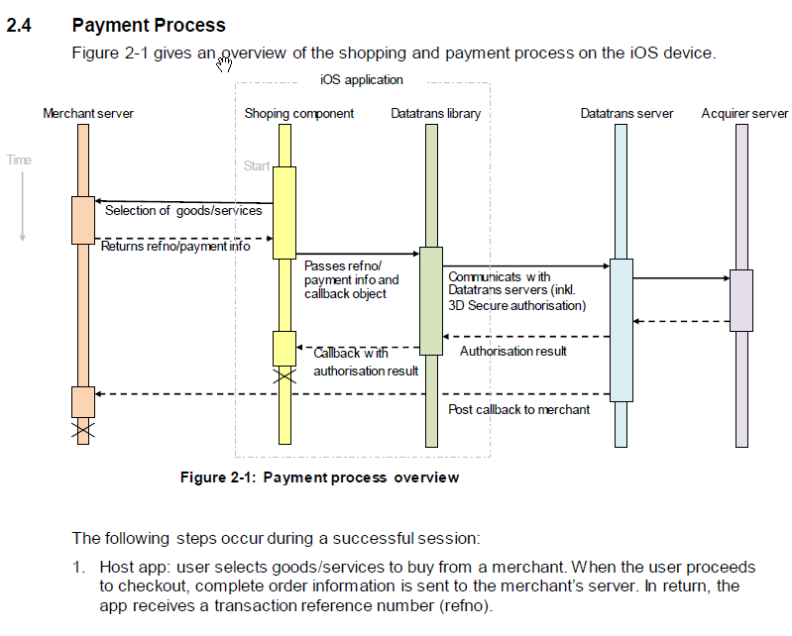
Payment Process

Slide 44
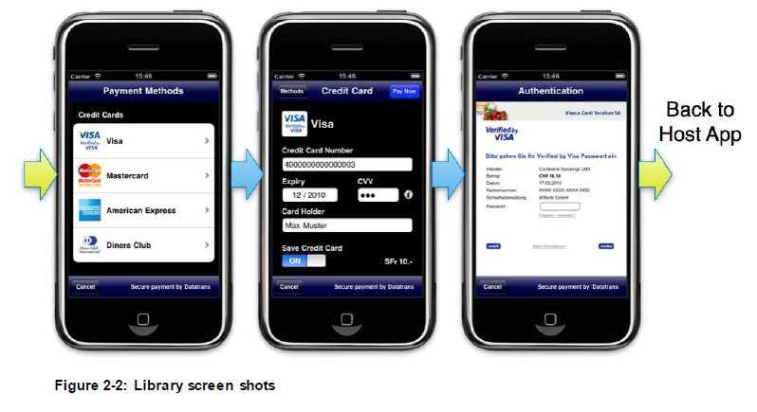
User Interface

Slide 45
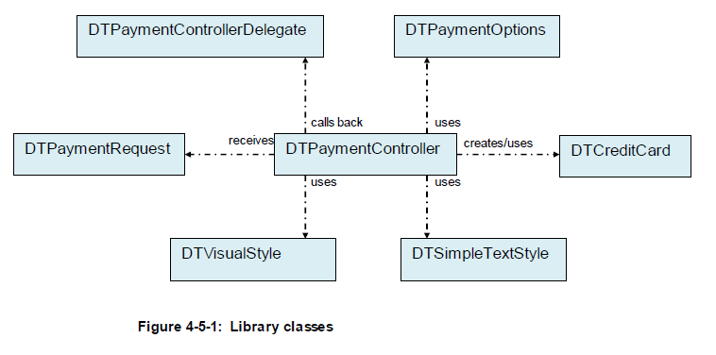
API Overview

Slide 46
Documentation APIs
Web / JavaScript
https://pilot.datatrans.biz/showcase/doc/Technical_Implementation_Guide.pdf
https://pilot.datatrans.biz/showcase/doc/XML_Authorisation.pdf
iOS library for iPhone, iPad, iPod Touch
https://pilot.datatrans.biz/showcase/doc/iOS_Release_Notes.pdf
https://pilot.datatrans.biz/showcase/doc/iOS_Developers_Manual.pdf
Android library
https://pilot.datatrans.biz/showcase/doc/Android_Release_Notes.pdf
https://pilot.datatrans.biz/showcase/doc/Android_Developers_Manual.pdf
https://github.com/datatrans/android-sample-app

Slide 47
@your service

Slide 48
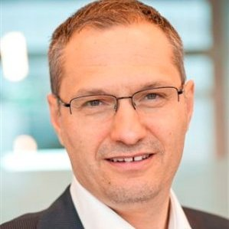
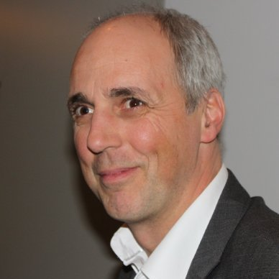
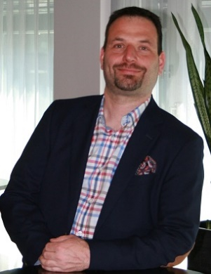
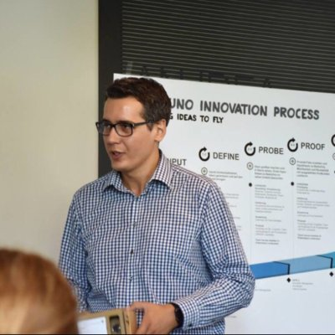
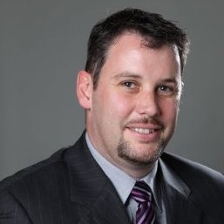


Workshop Support-Team
Tony Weber
Head of Innovation & Tech. Mgmt
Tony.weber@Aduno-gruppe.ch
079 336 34 53
@tonyweber12
Martin Fabini
Head of Project Mgmt.
Martin.Fabini@ti8m.ch
079 702 50 16
Stevan Dronjak
stevan.dronjak@raiffeisen.ch
Bedrija Hamza
Business Technology Manger
Bedrija.hamza@aduno-gruppe.ch
079 800 36 26
@hamzza
Marius Matter
Associate Principal
marius.matter@ti8m.ch
079 291 26 65
Stefan Jeker
Abt.-Leiter Elektronische Kanäle IT
stefan.jeker@raiffeisen.ch
079 897 97 17

Slide 49
Q&A
#ConvPayment
https://github.com/ti8m/HackZurich16

